Slide 1
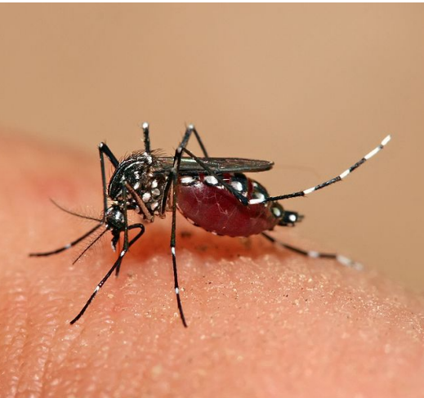
Project Title:
Aedes Aegypti mosquito (Dengue) breeding surveillance using drones in flooded regions of Chennai

Slide 2
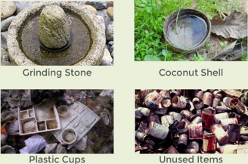
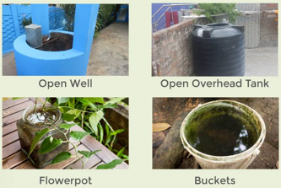
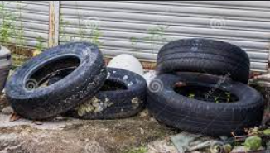
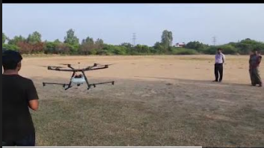
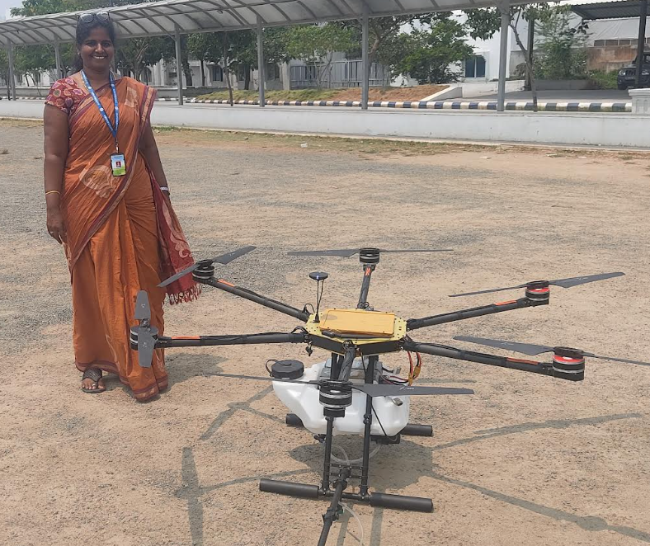
GAP IDENTIFIED
Possible Breeding Habitats(PBH)
Aedes is a day bitter and strongly anthropophilic
The dengue mosquito lays eggs (up to 100-120) simply on damp surfaces above the waterline
The eggs hatch when submerged in water. Eggs can survive for several months.
Only female mosquitoes transmit dengue viruses from infected persons to others.
Aedes mosquitoes prefer to bite humans and infect several persons in the same household.
Weekly intervention is required to control PBHs
PBH increases During Monsoon and Post Monsoon due to rains
In tropical countries the dengue transmission is perennial
There is no spatial and temporal analysis.
Requires more manpower and cost, more inaccessible areas, harmful to corporation workers
Uncontrolled Larvicide usage
No proper image dataset available
PROOF OF CONCEPT
Fertilizer Spraying Drone Developed using Seed Funding
Total cost: Rs.9,00,000
Role: Co-Investigator

Slide 3
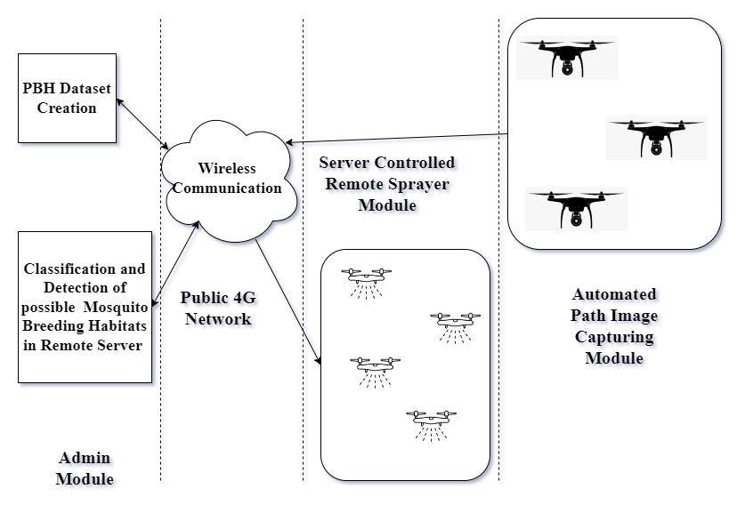
PROPOSED OBJECTIVES
Distributed Drone–Based Aedes PBH Surveillance and Control System Architecture
Identification of PBH using CNN
Effective Larvicide Spraying using Drone
METHODOLOGY
Image Capturing module:
-Travel in an automated path.
-Collects high-resolution images, videos, and thermal pictures
in aerial view (30 to 40 m height).
-Send image information of the monitored area to the server
periodically using a Wi-Fi module
PBH Dataset Creation:
- An expressive no of samples for each object class
- All videos are manually annotated frame by frame using CVAT S/w
- Spatio Temporal Dataset
Admin module:
Receives information from the image capturing module through Wi-Fi Receiver.
Deal frame-wise information of captured image data.
Identify objects using spatial and temporal attributes using the CNN model
Compare objects with the past 3 days’ captured data set using CNN and identify the presence of water using thermal features
Based on the water level threshold in the identified object and classify as possible breeding habitat(PBH) or Not.
PBH location-specific information sent to Larvicide Sprayer Module.(Manual/Automatic)
Sprayer Module:
Mosquito Larvicidal Oil(MLO) is used to control the Aedes Larvae.
Receives PBH information from the admin module.
Adjust its position and the Sprayer actuator performs its operation based on the received information.

